Slide 1
IMDB Movie Analysis
- VINIT KUMAR

Slide 2
Project Description
This project aims to determine the key factors contributing to a movie’s success, as measured by its IMDB Rating. Identify the patterns and correlations that can inform strategic decision-making for the film industry. The insights from this analysis will be valuable for producers, directors, and investors as they help them make informed choices for future projects.

Slide 3
Approach
Downloading and understanding the given dataset.
Data Cleaning – Cleaning the dataset by removing the unnecessary columns, after that finding blank cells and removing corresponding rows and outliers.
Insights Extraction – Generating insights from the cleaned dataset by applying functions and formulas.
Descriptive Statistics – Calculating Mean, Median, Mode, Variance, Standard Deviation and Range when required.

Slide 4
Tech – Stack Used
Microsoft Excel 2021 for Data Analysis process which includes data cleaning, modelling, analysis, and visual representation of data.
Microsoft PowerPoint 2021 for report creation and summarizing insights.

Slide 5
Insights
Movie Genre Analysis
Determine the most common genres of movies in the dataset.

Slide 6
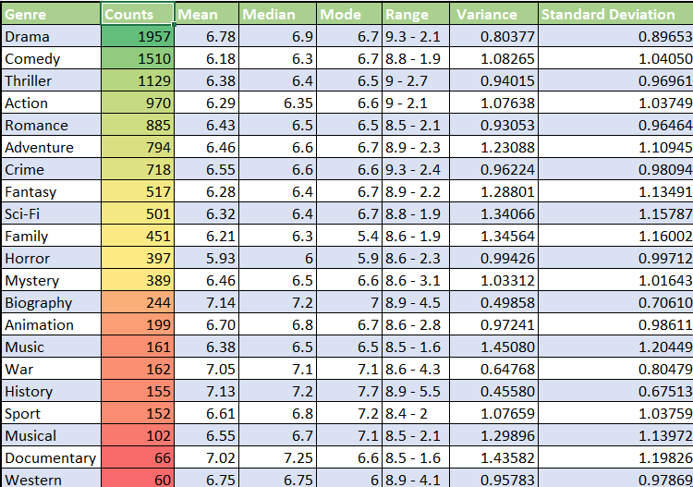

Slide 7
The most popular genre is Drama having a movie count of 1957, an average IMDB score of 6.78 and an IMDB range of 9.3 to 2.1.
Maximum & Minimum average IMDB score is 7.14 & 5.93 for the genre Biography & Horror respectively.
The top 3 popular genres are:
Drama
Comedy
Thriller.
The least 3 popular genres are:
Western
Documentary
Musical.

Slide 8
Movie Duration Analysis
Analyse the distribution of movie durations and identify the relationship between movie duration and IMDB score.

Slide 9
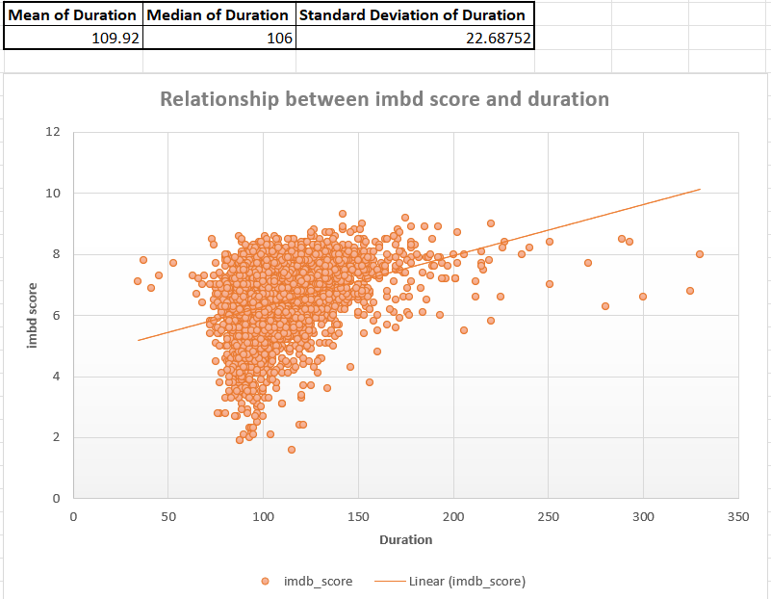

Slide 10
The average movie duration is 109.92.
The median movie duration is 106.
The standard deviation is 22.68752.
A movie having a duration of 142 minutes has the highest IMDB score of 9.3.
The lowest IMDB score is 1.6 and the same movie has a duration of 115.
The scatter plot indicates the moderate positive relationship between movie duration and IMDB score as the trend line is upward.
The standard deviation is not too large, the mean and median are also close which means the dataset is normally distributed.

Slide 11
Language Analysis
Determine the most common languages used in movies and analyse their impact on the IMDB score using descriptive statistics.

Slide 12
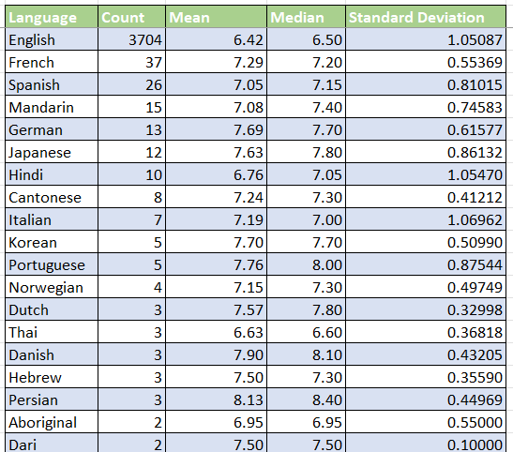
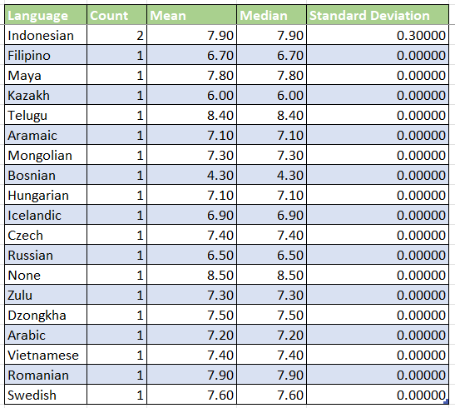

Slide 13
Only 7 languages have a count equal to or greater than 10.
The movie language which has the most counts is English with 3704 counts.
In Hindi, the standard deviation is the highest, 1.054.
The gap between English and other languages is too large.
German language has 7.69 the highest average IMDB score.
Japanese language has 7.80 the highest IMDB score median.

Slide 14
Director Analysis
Identify the top directors based on their average IMDB score and analyse their contribution to the success of movies using percentile calculations.

Slide 15
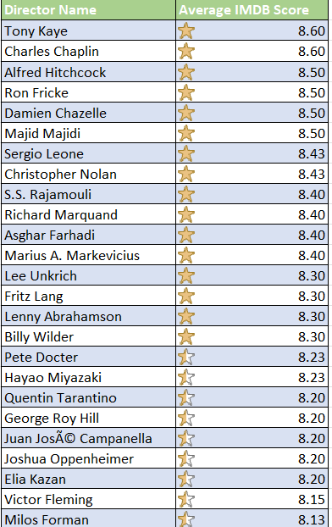
The 90th percentile for each director is 7.5.
The total number of directors having an IMDB score greater than or equal to 7.5 is 187.
The top 3 directors are:
Tony Kaye
Charles Chaplin
Alfred Hitchcock

Slide 16
Budget Analysis
Analyse the correlation between movie budgets and gross earnings, and identify the movies with the highest profit margin.

Slide 17

Avatar has the maximum profit margin which is 523505847.
The correlation between gross earning and budget is 0.10208 which is near 0, which means the relation between gross earnings and budget is weak.
The top 5 movies having high-profit margins are:
Avatar
Battleship
King Kong
Never Let Me Go
My Bloody Valentine

Slide 18
Results
Genres: Genres like Drama, Comedy, and Thriller are more popular than genres like Documentary and Western.
Duration: Movies with the duration between 130 to 150 minutes has better ratings.
Directors: Movies directed by famous directors generally have high ratings.
Budget: The moderate positive correlation between budget and IMDB score which means movies with a higher budget have a high chance of better rating, due to better production quality and marketing.

Slide 19
Link of the Excel Workbook (Both link and hyperlink are given).
Excel Workbook Link
https://docs.google.com/spreadsheets/d/1XhXU56mLq7SwL3wphL5Z2oY3CJOg1J7P/edit?usp=sharing&ouid=109445397656419215131&rtpof=true&sd=true
Link of the Video Presentation (Both link and hyperlink are given).
Video Presentation Link
https://drive.google.com/file/d/1Roud9WzOnXMg37QqHqHH1ROT8IouHkYQ/view?usp=sharing

Slide 20
THANK YOU

